Slide 1
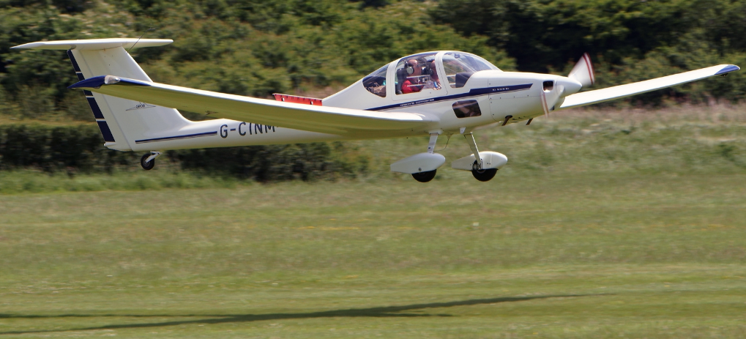
CROSSWIND TECHNIQUES
Grob 109B

Slide 2
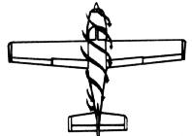
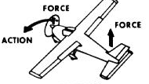
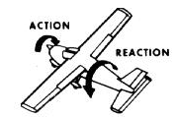
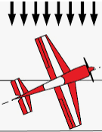
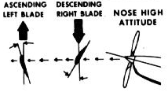
Causes of YAW
Slipstream
Precession
Torque
Crosswind
P-Effect

Slide 3
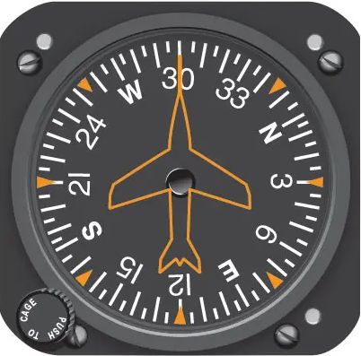
How Much Crosswind?
Northerly @ 15kts
Runway 30
Headwind:
7.5 kts
Crosswind:
13 kts

Slide 4
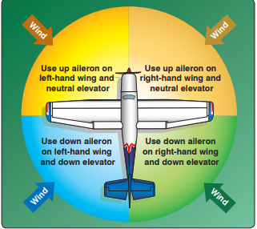
Taxying
Climb into the wind
Dive away from the wind
Don’t taxy using brakes against power
Burst of power gives rudder authority
Ground Loop:
Once past ~75º brakes will accelerate loop
T-Tail – outside slipstream

Slide 5
Crosswind Limitations
Most aircraft manuals do NOT use the term “Limitation” with relation to Crosswinds
Term used is “Demonstrated Crosswind Capability”
Crosswind that happened to be present when it was demonstrated
That said … as always consider your insurance

Slide 6
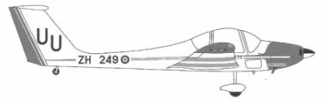
Take-Off
Allow the aircraft to fly itself off
Choose when it flies
25kts
50kts

Slide 7
Landing
Controls co-ordinated – balance ball in the middle while at altitude
Wings level close to the ground
Wing Drop (more gently the slower you are) / may also cause pitch change
Too early (will start drifting) or too late – sideways load on undercarriage
Fully held off landing / Stick fully back when on ground

